Slide 1
LAW & ORDER ARRANGEMENTS FOR ELECTIONS

Slide 2
TRAINING OF POLICE OFFICIALS AS PART OF THE SYSTEMATIC TRAINING PLAN
LEVEL | ORGANIZED BY | FACILITATED BY | PARTICIPANTS
STATE | DGP | CEO | All senior officers up to the level of SP
DISTRICT | SP | DEO | All senior district officers up to the level of DSP/SDPO
SUB-DIVISION | SDPO/ DSP | SDO/ RO | All officers up to the level of SI
S | OC, PS | BDO/ ARO | ASI & constabulary
POLICE LINE, TI | SP/ TI | DEO | All trainee officers/ force

Slide 3
PRE-POLL
DURING POLL
POST POLL

Slide 4
PRE-POLL
L & O PLANNING
PREVENTIVE MEASURES
ENFORCEMENT OF MCC
VEHICLE MONITORING
EXPENDITURE MONITORING

Slide 5
PLANNING FOR LAW AND ORDER MEASURES DURING ELECTION
VULNERABILITY MAPPING
IDENTIFICATION OF VULNERABLE AREAS
FORCE DEPLOYMENT PLAN FOR VULNERABLE AREAS
CRITICALITY ASSESSMENT
IDENTIFICATION OF CRITICAL POLLING STATIONS
FORCE DEPLOYMENT PLAN FOR CRITICAL POLLING STATIONS

Slide 6
VULNERABILITY MAPPING
Identify vulnerable areas, polling station-wise
Identify source of threat/ intimidation
Identify names of persons likely to spearhead such offence of undue influence
Take into cognizance past incidents and present apprehensions
Identify points of contact
Initiate preventive/ confidence building measures

Slide 7
Preparation of VM reports
3 Phase reports to be prepared to identify:
Pockets of vulnerability
Intimidators as apprehended by the voters to affect free & fair election
VM-SO
VM- RO
VM-DEO
All reports to be compiled ,cross verified & action taken to remove cause of vulnerability

Slide 8
ACTION POINTS ON VULNERABILITY MAPPING
Identification of Sectors- Civil & Police
Civil & Police Sector must be co terminus
Extensive movement by DEO,RO,ARO,SDM,BDO, Senior police officer for Confidence Building Measures ( CBM) in vulnerable areas & interactions with the common people thereof
Visits to be videographed
Available forces to be tagged with the visits

Slide 9
Action Points on Vulnerability mapping
DAILY LAW AND ORDER REPORT AND REVIEW OF THE REPORT
IDENTIFICATION OF THE VULNERABLE VILLAGES AND TROUBLE MONGERS
TO UPDATE THE LIST OF HISTORY SHEETERS
PREVENTIVE ACTION AGAINST TROUBLE MONGERS, BOOTLEGGERS. REGULAR BLOCK RAID TO ARREST PERSONS INVOLVED IN SPECIFIC CASES
AREA DOMINATION POINT PATROLLING AND FLAG MARCH BY CAPF
EXECUTION OF THE NON-BAILABLE WARRANTS
TO EFFECT SERVICE OF ALL PENDING WARRENTS
SPECIAL DRIVE TO EXPEDITE INVESTIGATION AND PROSECUTION OF ALL THE ELECTORAL OFFENCES
PROHIBITORY ORDER U/S 144 CrPC WHERE NEEDED.
TO UNEARTH AND SEIZE ILLICIT LIQUOR. ENFORCEMENT OF EXCISE LAW. REGULAR CHECKING OF ID LIQUOR DENS
TO UNEARTH AND SEIZE UNLICENSED ARMS. SCRUTINY OF LICENSE OF ARMS AND AMMUNITION SHOP. DEPOSITION OF LICENSED ARMS AND SAFE CUSTODY
STRICT CHECKING OF VEHICLES TO PREVENT ENTRY OF CASH, ILLIGAL LIQUOR AND ARMS INTO THE CONSTITUENCY
ACTION AGAINST SENDING OF OBJECTIONABLE BULK SMS. PROHIBITION OF SENDING BULK SMS OF POLITICAL NATURE DURING LAST 48 HOURS BEFORE END OF POLL

Slide 10
CRITICALITY ANALYSIS
Identify critical polling stations
Higher number of non-epic electors
Higher number of missing voters without family linkage
Polling stations having vulnerable pockets
Above 90% votes polled out of which above 75% in favour of a particular candidate
Re-poll reported due to malpractices, and where electoral violence has taken place during last election
TO BE DONE BY DEO/ POLICE TO PROVIDE INPUTS ON 3 & 5

Slide 11
Identification of critical polling stations
ECI No 464/INST/2014-EPS dt 12.3.2014
All polling stations where percentage of votes polled was more than 90% and where more than 75% of votes have been polled in favour of one candidate shall be identified as critical polling stations
To be done in reference to the election results available in Form 20 of past general election.

Slide 12
CRITICALITY ANALYSIS
Also to take account of :
PS affected by LWE activity
Rivalry between political parties
Political sensitivity
Pronounced presence of criminals
Communal tension
Caste based tension

Slide 13
ACTION POINTS FOR CRITICAL POLLING STATIONS
1. CPF deployment
2. Deployment of Micro Observers
3. Deployment of digital/ video camera
4. Strict enforcement of voting with EPIC/ alternative id document
5. Special vigil by the CPF
TO BE DONE BY DEO/ POLICE TO PROVIDE SUPPORT ON 1 & 5

Slide 14
SECURITY FORCE DEPLOYMENT PLAN
Full and optimal utilisation of CPF and SAPF to be ensured.
STATE DEPLOYMENT PLAN - To be prepared in consultation with CEO by taking into account of available forces of state police/SAPF AND CPF made available by the MHA.
DISTRICT DEPLOYMENT PLAN - To be prepared under the chairmanship OF DM/DEO - And to be approved by OBSERVERS (SKETCH MAP OF SECTORS, VULNERABLE POCKETS AND CRITICAL POLLING STNS IDENTIFIED)
DEPLOYMENT OF ANY FORCE (OTHER THAN STATE POLICE AND CPF) i.e. Temporarily raised HOME GUARDS etc., Will require prior permission of ECI
NO DEVIATION WITHOUT EXPRESS PRIOR APPROVAL OF OBSERVER

Slide 15
SECURITY FORCE DEPLOYMENT PLAN
SECURITY FORCE DEPLOYMENT PLAN
Security cover to contesting candidates only as per assessment of threat, and not in routine manner
Adequate security for observers
Three-tier cordoning system to be set up in counting centres
Sealing of inter-state borders/inter-district borders, well in advance to prevent infiltration of anti-social and disruptive elements.

Slide 16
SECURITY FORCE DEPLOYMENT PLAN
SECURITY FORCE DEPLOYMENT PLAN
For guarding strong rooms after the poll, CPF will be used
The deployment of forces shall be made at the polling station by the following order of sensitivity- CPF followed by SAPF and then by DAPF.
Additional measures at critical polling stations - as per criteria.

Slide 17
SECURITY FORCE DEPLOYMENT PLAN
SECURITY FORCE DEPLOYMENT PLAN
CPF not to be kept as strike reserve etc..
CPF to be used for the purpose of area domination, conducting flag march, confidence building among electors etc., till 2 days before the poll.
On the poll day CPF to be assigned duties of guarding polling stations, poll material, polling personnel and the poll process and not to look after law and order.

Slide 18
SECURITY FORCE DEPLOYMENT PLAN Ref No. PS/AK/2005 dt 30/9/2005 All Polling Station to be covered by effective static armed force backed up with proper mobile strike force. Polling parties and Static armed force will reach Polling Station at least P-1 day. EVM to be handed over to the Polling parties if the static armed force for the Polling Station is present. CAPF to take position in the assigned PS on P-1 day. After poll polled EVM and Polling team to be escorted by the CAPF or the State Armed Force to the RC as per the approved deployment plan State Police Force remains responsible for maintenance of general law & order and any other specific poll related duty. to provide force for sector, NAKA points, SST, VST, Flying Squad, for MCC enforcement, QRT apart from the points mentioned above

Slide 19
ROLE/ RESPONSIBILITIES OF CAPF ( PRE-POLL)
TO ESTABLISH BETTER NETWORK WITH LOCAL POLICE
AREA DOMINATION
CONFIDENCE BUILDING MEASURES LIKE FLAG MARCH, POINT PATROLLING, SANITISATION (LWE AREAS), VISIT OF VULNERABLE VILLAGES
ADDITIONAL DEPLOYMENT AT THE CHECKPOSTS

Slide 20
ROLE/RESPONSIBILITIES OF CAPF (POLL DAY)
GUARDING POLLING STATION, POLL MATERIALS, POLLING PERSONNEL AND THE POLL PROCESS
STATIC GUARDING OF THE TROUBLE SPOTS
PATROLLING AS FLYING SQUAD
ESCORTING OF THE POLLED EVM TO RC
GUARDING POLLED EVM UNTIL COUNTING

Slide 21
ROLE/RESPONSIBILITIES OF CAPF (POST POLL)
TO FORM INNER CORDON TO PROTECT THE COUNTING CENTRE
GUARDING OF POLLED EVM TILL COUNTING
ESCORTING THE STATUTORY PAPERS TO STRONG ROOM AFTER COUNTING

Slide 22
ROLE/RESPONSIBILITIES OF STATE POLICE (PRE POLL)
TO MAINTAIN GENERAL LAW AND ORDER
TO TAKE PREVENTIV ACTION
TO ESTABLISH CHECK POSTS AND PREVENT ILLEGAL MOVEMENT OF CASH, LIQUOR, DRUGS, ANTI-SOCIAL ELEMENTS
VULNERABILITY MAPPING
IMPLEMENT MCC
IMPLEMENT ELECTION EXPENDITURE MONITORING
HANDLE VIP MOVEMENT
IMPLEMENT DEPLOYMENT PLAN
TO PROVIDE LOGISTIC SUPPORT TO CAPF

Slide 23
ROLE/RESPONSIBILITIES OF STATE POLICE ( POLL-DAY)
MAINTENANCE OF GENERAL LAW AND ORDER
SAFETY OF VOTERS, POLLING PERSONNEL AND POLLING MATERIALS
IMPLEMENTATION OF MCC
ELECTION EXPENDITURE MONITORING
ANY OTHER SPECIFIC POLL RELATED DUTY ASSIGNED UNDER SECURITY DEPLOYMENT PLAN

Slide 24
ROLE/RESPONSIBILITIES OF STATE POLICE ( POST-POLL)
MAINTENANCE OF THE GENERAL LAW AND ORDER
OUTER CORDON FOR THE POLLED EVM STRONG ROOM AND COUNTING VENUE
MAINTENANCE OF LAW AND ORDER DURING VICTORY PROCESSION AFTER COUNTING

Slide 25
USE OF CENTRAL POLICE FORCE
Static guarding of polling stations solely and exclusively by CPF,
(B) Patrolling duty on assigned routes (election sectors) covering a fixed cluster of polling stations;
(C) Patrolling duty as ‘flying squads’ in a defined area with surprise element;
(D) Escorting duty of polled EVM with polling personnel back to the receiving centre/strong room after poll is over;
(E) Any other duty which is necessitated to ensure purity and fidelity of the election process.

Slide 26
PRE-POLL
L & O PLANNING
PREVENTIVE MEASURES
ENFORCEMENT OF MCC
VEHICLE MONITORING
EXPENDITURE MONITORING

Slide 27
PREVENTIVE MEASURES
Maintenance of law & order
Execution of non-bailable warrants
Prosecution under 107 cr. pc to prevent breach of peace & binding under 116 cr. pc
Preparation of list of criminals & habitual offenders
Special drive for seizure of illegal arms/explosives
Surrender of licenced weapons

Slide 28
REGULAR SECURITY/ ANTI-CRIME MEASURES
Enforcement of excise law
Action against bootleggers
Regular checking of id liquor dens
Regular block raid to arrest persons involved in specific cases

Slide 29
REGULAR SECURITY/ ANTI- CRIME MEASURES-
Regular vehicle checking for anti-crime measures and suspicious movements
Regular checking at the entry and exit points to the city
Checking of hotels and guest houses for suspicious persons and outsiders
Surveillance over vital installations, religious places and other iconic structures

Slide 30
REGULAR SECURITY/ ANTI- CRIME MEASURES-
Surveillance through CCTV
Patrolling on vehicles/ bikes
Action against known rowdies
Random checking of bags amongst the pedestrians for suspicious articles
Regular foot patrolling
Monitor security of hotels, tourist locations, malls, market places, metro stations etc.

Slide 31
PREVENTIVE ACTION TO ENSURE CONDUCT OF PEACEFUL, FREE AND FAIR POLL
Police Station-wise list of persons having electoral offences in the past should be prepared.
List of other Criminals / habitual offenders should be prepared.
A special drive should be taken for execution of all pending warrants.
A special drive should be taken for expediting the investigation and prosecution of all pending cases of electoral offences.
Verification of stock of licensed arms and ammunition shop.
A special drive to unearth and seizure of illegal arms and ammunitions.
A special drive to unearth illicit liquor making factories.
(Instruction Sl. No. 66 & 79. ECI order No.464/96(L&O) dt. 17.1.1996. ECI letter No.464/ L&O/2007/PLN-I Dt.8.1.2007)

Slide 32
Restrictions on arms
Restrictions on possession of arms during election
Issue of license for arms is totally prohibited during the period from announcement of election till completion of election process.
Deposition of licensed arms with the District Authority, if required.
Prohibitory order U/sec. 144 of Cr.P.C. shall be issued barring the carrying of licensed arms during election process.
(Instruction Sl. No. 67 & 79. ECI order No.464/96-L&O/ PLN-1 dt.13.3.1996 & ECI order No.464.L7O/2007/PLN-I dated 08.12.2007)

Slide 33
RESTRICTION ON SALE OF LIQUOR
Section 135C of RP Act 1951 provides that no spirituous, fermented or intoxicating liquors or other substances of like nature shall be sold, given or distributed at a hotel, eating house, shop or any other place public or private with in polling area during the period of 48 hours ending with the hour fixed for closing of poll.
Such period is declared as “dry days”.
No hotel, restaurant, club and other establishment shall be permitted to sell / serve liquor to anyone whosoever on the aforesaid days.
Even licensed shops should not be permitted to do so.
Strict vigilance should be enforced on illegal storage and use of liquor.
(Instruction Sl. No.72,79 & 90. ECI letter No.576/14/ 99-PLN-1 dt.21.8.1999, ECI letter No.464/L&O/2007/PLN-I dated 08.12.2007 & ECI letter No. 576 /1 4 / 2007 / PLN -I dated 28.12.2007)

Slide 34
CHECKING OF STATE,INTER DISTRICT,INTERNATIONAL BORDER & PLACEMENT OF NAKA
Extensive Patrolling Duty on Assigned Routes covering the state/International Border
Meeting with neighbouring state/BSF for co ordination
Placement of Naka at strategic points with elements of surprise
Strict vigil/checking on vehicles on carrying of arms/explosives etc
Sealing of inter state/inter district borders to prevent infiltration of anti social and disruptive elements

Slide 35
DAILY REPORT ON LAW & ORDER (LAO-I)
HIGHLIGHTS
SEIZURE OF UNLICNESED ARMS/ WEAPONS
SEIZURE OF CARTRIDGES/ EXPLOSIVES
RAIDS ON ILLICIT ARMS MANUFACTURERS AND SEIZURES
LICENSED ARMS DEPOSITED/ IMPOUNDED/ CANCELLED
NO. OF PERSONS BOUND UNDER 107/116 Cr. PC

Slide 36
DAILY REPORT ON LAW & ORDER (LAO-I)
HIGHLIGHTS-
EXECUTION OF NON-BAILABLE WARRANTS
INCIDENTS OF VIOLENCE RELATED TO POLL CAMPAIGN/ POLITICAL RIVALRY
TOTAL KILLED
TOTAL INJURED
DAMAGE TO PROPERTY
POLICE ACTION TAKEN

Slide 37
RESTRICTION ON PRESENCE OF POLITICAL FUNCTIONARIES 48 HOURS BEFORE THE HOUR FIXED FOR CLOSE OF POLL
Political functionaries other than the national office bearer in charge of the state who are not voters are not allowed to stay within the constituency.
Police to check community halls, hotels, guest houses, lodges, other places of accommodation to ensure compliance
Special check posts at constituency borders and track vehicular movement from outside the constituency

Slide 38
RESTRICTION ON PRESENCE OF POLITICAL FUNCTIONARIES WITH SECURITY COVER
Political functionaries with security cover shall not be allowed to remain present in a constituency where they are not voters after the end of the campaign period
Restricted movement of political functionaries who are voters in the constituency after they cast their vote
Restriction not applicable to the candidates

Slide 39
PRE-POLL
L & O PLANNING
PREVENTIVE MEASURES
ENFORCEMENT OF MCC
VEHICLE MONITORING
EXPENDITURE MONITORING

Slide 40
ENFORCEMENT OF MODEL CODE OF CONDUCT (MCC)
Political meetings- equitable allocation of space/ venue
Meetings with permission only. PROPOSED EXPENDITURE ON MEETING IS ALSO TO BE INCLUDED IN THE LETTER SEEKING PERMISSION in form 16.-To be covered by MCC team & VST
PROCESSIONS- APPROPRIATELY COVERED by VST
Use of vehicles- only with express permission from the CEO/DEO/RO
Action on wall-writing/ postering/ other form of canvassing
Restrictions on use of loudspeakers

Slide 41
ACTION AGAINST DEFACEMENT OF PROPERTIES
LEGAL PROVISIONS
West Bengal Municipal Second Amendment Act,2006
Howrah Municipal Corporation (Amendment) Act, 2006 & 2008
RESTRICTIONS
No defacement of public buildings
Defacement of private buildings, only with written consent of the owner
West Bengal Pacnahayt (Third Amendment) Act, 2006
ECI Instruction No. 3/7/2008/ JS-II dtd 7/10/08 & 3/7/2008/ JS-II dtd. 10/11/08

Slide 42
RESTRICTIONS
NO ADVERTISEMENT ON
building/ structure owned by the state/ central government/ any local authority
buildings/ fence of an educational institution or hospital
buildings used for religious purpose
gate or exit requirement of any building
electrical installations (transformer, lamp post etc.)
water supply installations
public transport
heritage buildings
road, if that obstruct traffic/pedestrial movement

Slide 43
RESTRICTIONS
Advertisements on private buildings allowed
With written permission from the owner
When it does not obstruct
Doors
Windows
Ventillation shaft
Chimney
Ac
Balcony
Any other portion covered with iron grill

Slide 44
ACTION AGAINST VIOLATION
If not complied within 3 days, fir lodged by RO, case registered by OC & the RO arranges removal
RO issues notice to the party/ candidate for removal
SDPO/ DSP report to RO/ DEO
OC, PS to monitor & identify cases of violation/ report to SDPO/ DSP

Slide 45
Absolutely no time limit on defacement of Government Property-
Should be removed immediately by the Offender

Slide 46
PRE-POLL
L & O PLANNING
PREVENTIVE MEASURES
ENFORCEMENT OF MCC
VEHICLE MONITORING
EXPENDITURE MONITORING

Slide 47
VEHICLE MONITORING
VEHICLE USE BY MINISTERS
VEHICLE USE BY CANDIDATES/ PARTIES
POLL DAY USE
REQUISITION OF VEHICLES

Slide 48
VEHICLE USE BY MINISTERS
No red light
Official vehicle only from residence to office (hq) and back
CEO to be informed on the visit of ministers outside hq
Ministers cannot combine official and non-official/ electioneering work

Slide 49
VEHICLE USE BY CANDIDATES/ PARTIES
For filing nomination, only three vehicles per candidate within 100 metre radius of the RO/ARO office
No stipulation as to the number of vehicle to be used during the campaign period
No campaign vehicle without pass issued by the RO
If users of any of the authorised vechicles indulge in unlawful activities, the vehicle shall be impounded and shall not be allowed to be used till the election process is over

Slide 50
VEHICLE FOR STAR CAMPAIGNERS
Enlisted star campaigners will be issued vehicle permit by the CEO office
Only the star campaigner to use such vehicle for his/ her own travel
The star campaigner is to ensure that the permit is not misused
The permit is to be displayed while the vehicle is in use

Slide 51
POLL DAY USE
On the day of poll there would be authority to use
One vehicle by the candidate
One vehicle by the election agent
One vehicle by the workers
Passes would be issued by the deo/ ro
Only 4+1 persons can be accommodated in a vehicle
Strict ban on carrying of voters in those vehicles

Slide 52
REQUISITION OF VEHICLES
State government vehicles
Vehicles of central government offices/ undertakings
Commercial vehicles
Private vehicles
In order of priority as above
Requisition with proper documents
No unnecessary detention
No avoidable harassment to the vehicle owners
Payment of compensation immediately on completion of election

Slide 53
PRE-POLL
L & O PLANNING
PREVENTIVE MEASURES
ENFORCEMENT OF MCC
VEHICLE MONITORING
EXPENDITURE MONITORING

Slide 54
WHAT IS EXPENDITURE MONITORING?
A PROCESS BY WHICH ELECTION COMMISSION KEEPS TRACK ON THE EXPENSES INCURRED BY THE CONTESTING CANDIDATES IN COURSE OF AN ELECTION IN ORDER TO PROVIDE A LEVEL PLAYING FIELD FOR ALL & MITIGATE USE OF MONEY POWER.

Slide 55
STEPS IN EXPENDITURE MONITORING
Candidate opens bank account , single operator/ joint operator with election agent, at leaset 1 day prior to filing of nomination
RO/ARO hands over registers and instructions to candidates
Candidate maintains accounts in the register given
DEO forms different teams to monitor expenses
Shadow observation register maintained by the accounting team
Assistant Expenditure Observer oversees
Expenditure observer oversees, examines accounts

Slide 56
Expenditure Monitoring Cell

Slide 57
TEAMS REQUIRING POLICE PERSONNEL
VIDEO SURVEILLANCE TEAM
Since this team is supposed to cover different meetings organised by politicalparties/ candidates, they may require presence of police personnel for protection
FLYING SQUAD
this team would be at the constituency level and will have adequate force under an Executive Magistrate

Slide 58
STANDARD OPERATING PROCEDURE FOR SEIZURE AND RELEASE OF CASH AND OTHER ITEMS.
ECI no.76/INSTRUCTIONS/EEPS/2015/VOL-II DATED 29TH MAY, 2015- ANNEXE-73
Commission has issued this order in suppression of its earlier order No. 76/Instructions/2015/vol. XIX dated 30th December, 2014.
The detailed instructions including the Standard Operating Procedure for deployment of the Flying Squads, Static Surveillance Team, for seizure and release of cash and other items during election process including the involvement of the DEO, the Police, the other district functionaries attached to the process, the Superintendent of Excise, the nodal officer of the Income Tax department has been laid down in the Order.

Slide 59
Flying Squad (FS)
There shall be three or more Flying Squads (FS) in each Assembly Constituency /Segment.
The FS shall start functioning from the date of announcement of election and shall continue till completion of poll.
The Flying Squad shall :
attend to all model code of conduct violations and related complaints;
attend to all complaints of threat, intimidation, movement of antisocial elements, liquor, arms and ammunition and large sum of cash for the purpose of bribing of electors etc.;
Whenever the BAG provides any information, the Flying Squad should reach the spot within shortest possible time and take necessary action and gather corroborative evidences.
attend to all complaints regarding election expenditure incurred or authorized by the candidates I political party;
Videograph with the help of Video Surveillance Team (VST), all major rallies, public meetings or other major expenses made by political parties after the announcement of election by the Commission.

Slide 60
In Expenditure Sensitive Constituencies (ESC), there shall be more FSs,
The FS shall not be given any other work
The names and mobile numbers of the Magistrate as head of the FS and other officials in FS shall be provided to the Complaint Monitoring Control Room and Call Centre, RO, DEO, General Observer, Police Observer, Expenditure Observer and Assistant Expenditure Observer.
In ESCs, CPF or State Armed Police may be mixed in the FS, depending on the situation.
The entire proceeding of the FS shall be video recorded.
All the vehicles used by the Flying Squads shall be fitted with the CCTV cameras! webcams or shall have video cameras (keeping in view the availability and economic viability) for recording the interception made by the Flying Squads

Slide 61
Responsibility of Magistrate in FS
The Magistrate of the FS will ensure that proper procedure is followed and there is no law and order problem.
The Magistrate of the FS shall send a Daily Activity report in respect of items of seizure of bribe or cash to the D.E.O. in a format as per Annexure – B8, with a copy to R.O., S.P. and the Expenditure Observers.
shall send Daily Activity report in respect of model code of conduct violations to RO, DEO, S. P. and General Observer in the format as given in Annexure-B9.
The S. P. shall send daily activity report to Nodal Officer of Police Headquarter, who shall compile all such reports from the district and send a consolidated report in the same format ( i.e.,: Annexure – B8 & B9) on the next day by fax/ e-mail to the Commission with a copy to the CEO of the state.
Responsibility of in Charge of FS
In case of suspicion of commission, of any crime, the in charge Police Officer of FS shall
seize cash or items of bribe or other such items, and
gather evidence and record statement of the witnesses and the persons from whom the items are seized and
issue proper Panchnama for seizure to the person from whom such items are seized.
He shall ensure that case is submitted in the Court of competent jurisdiction within 24 hrs.

Slide 62
file complaints/F.l.R. immediately against
the persons, receiving and giving bribe; and
any other person from whom contraband items are seized, or
any other antisocial elements found engaged in illegal activity.
The copy of the complaint/FIR shall be displayed on the notice board of the R. 0. for public information and be sent to the DEO, General Observer, Expenditure Observer and Police Observer.
The Expenditure Observer shall mention it in the Shadow Observation Register, if it has links with any candidate's election expenditure.

Slide 63
SST Covering for FS
In case, a complaint is received and it is not possible for the FS to reach the spot immediately, then the information shall be passed on to the Static Surveillance Team, nearest to the spot or to the police station of that area, who shall rush a team to the spot for taking necessary action on the complaint. All seizures made by the police authorities either on receipt of complaints forwarded by FS or received independently shall also be reported to the FS which shall incorporate such seizure reports in its Daily Activity Reports in relevant rows/columns.

Slide 64
Each FS shall announce through a Public address system, fitted onto its vehicle, the following in local language in the area under its jurisdiction:
"As per section 171 B of Indian Penal Code, any person giving or accepting any gratification in cash or kind during election process, with a view to inducing the person to exercise his electoral right is punishable with imprisonment up to one year or with fine or with both. Further, as per section 171 C of Indian Penal Code, any person who threatens any candidate or elector, or any other person, with injury of any kind, is punishable with imprisonment up to one year or with fine or both. Flying Squads have been formed to register cases against both the giver and the taker of bribe and for taking action against those who are engaged in threat and intimidation of electors. All the Citizens are hereby requested to refrain from taking any bribe and in case, anybody offers any bribe or is having knowledge about the bribe or cases of threat/intimidation of electors, then he should inform on the toll free number…………………. , of the 24x7 Complaint Monitoring Cell of the district, set up for receiving the complaints".

Slide 65
Responsibility of DEO as regards functioning of the FS
monitoring mechanism, which is being put in place during election process.
The DEO shall constitute the FS with officers of proven integrity.
The DEO shall publish pamphlets quoting the appeal to public in English or Hindi or local language and distribute through the flying squad in prominent places.
Press release should also be issued by the DEO on the election expenditure monitoring measures.
after the announcement of elections, DEO shall make an appeal as mentioned in para 8 above in print and. electronic media for the benefit of general public about the Checking by SST on the major roads or arterial roads shall commence from the date of notification of election.

Slide 66
Static Surveillance Team (SST)
There shall be three or more Static Surveillance Teams in each Assembly Constituency/Segment with one executive magistrate and three or four police personnel in each team who shall be manning the check post.
Depending on the sensitivity of the area, the CPF members will be mixed in the SSTs.
This team shall put check posts at Expenditure Sensitive pockets/hamlets, and shall keep watch on movement of illicit liquor, items of bribe, or large amount of cash, arms and ammunition and also movement of antisocial elements in their area.
The entire process of checking shall be captured in video or CCTV.
The video/CCTV record with an identification mark of date, place and team number shall be deposited with the R.O, on the next day who shall preserve the same for verification by the Commission at later point of time. It may also be widely advertised by the DEO that any member of the public can obtain a copy of the video/ CCTV record by depositing Rs. 300/-.

Slide 67
Whenever Check Posts are put at the borders of the district/State or at any other place by any agency, for any purpose, then the nearest SST shall be present there in such team, to avoid duplication of checking in the area and reporting of seizure of cash or items of bribe has to be done by the SST.
The SSTs shall be controlled by the DEO and S.P. in consultation with General Observer and Expenditure Observers and the mechanism shall be strengthened in last 72 Hrs. before the poll, particularly in vulnerable areas or in Expenditure sensitive pockets and during such period, ·the SST shall not be dismantled under any circumstances.
No checking shall take place without the presence of Executive Magistrate.
During checking, if any cash exceeding Rs. 50,000/- is. found in a vehicle carrying a candidate, his agent, or party worker or carrying posters or election materials or any drugs, liquor, arms or gift items which are valued at more than Rs.1O,O0O/-, likely to be used for inducement of electors or any other illicit articles are found in a vehicle, shall be subject to seizure.

Slide 68
After seizure, the seized amount shall be deposited in such manner as directed by the Court and a copy of seizure of cash, in excess of Rs. 1O lacs shall be forwarded to the Income Tax authority, engaged for the purpose.
The DEO shall issue necessary instructions to the treasury units to receive the seized cash beyond office hours and on holidays also, in case it is required.
The Magistrate of the SST shall send Daily Activity report to the D.E.O. with copy to R.O., S.P. and Expenditure Observer, General Observer, and Police observer in a format as per Annexure -C, on the same day.
The S.P. shall send daily activity update to Nodal Officer of Police Headquarter, who shall compile all such reports from the district and send a consolidated report in the same format ( i.e., Annexure – B10) on the next day by fax/ e-mail to the Commission with a copy to the CEO of the state.

Slide 69
Exemption from Seizure by SST
If any star campaigner is carrying cash up to Rs. 1 Lakh, exclusively for his/her personal use, or any party functionary is carrying cash with certificate from the treasurer of the party mentioning the amount and its end use, then the authorities in SST shall retain a copy of the certificate and will not seize the cash.
If cash of more than 10 lakh is found in a vehicle and there is no suspicion of commission of any crime or linkage to any candidate or agent or party functionary, then the SST shall not seize the cash. and pass on the information to the Income-Tax authority, for necessary action under Income - Tax Laws

Slide 70
Responsibility of in Charge of SST
the seizure of cash or any item shall be done by the in charge Police Officer of the SST as per provision of CrPC in presence of the Executive Magistrate
The Police Officer in charge of SST shall file complaint/FIR in the Court, having jurisdiction, within 24 hours.
FS and SST shall be polite, decent and courteous, while checking the baggage or vehicle. The purse held by the ladies shall not be checked, unless there is a lady officer. The FS shall also supervise the functioning and proper conduct of SSTs during checking in their areas.

Slide 71
TRAINING OF FST AND SSTS
Advance training of FSs and SSTs should be done as per direction of the Commission. The DEO and the SP of the district shall ensure that the teams are constituted and properly trained. The Nodal Officer at the Police Headquarters shall ensure that proper training- and sensitization of the police force is this regard is done.

Slide 72
Complaint against functioning of FST & SST
In case of any grievance about the conduct of the FS or SST, the Authority, whom the person can appeal for redressal of grievance on misconduct or harassment shall be the Addl. District Magistrate of the district (in charge of the Expenditure Monitoring Cell).
All the vehicles, used by SSTs and FSs may be fitted with GPRS enabled tracking unit so that timely action by the teams can be monitored.

Slide 73
Standard Operating Procedure -use of aircraft
All procedure of frisking and checking of persons and baggage to be strictly enforced.
ATC to inform CEO 24 hrs in advance the flight plan.
At remote/uncontrolled airports .the police authorities will carry out the screening and checking of baggage.
At non commercial airstrips and helipads ,application will have to be made either by the candidate or by the political party to the DEO at least 24 hrs before landing.
DEO will issue permission on the same day.
Local police will frisk and check all passengers boarding the helicopters except specially exempted persons
Entire process is to be videographed.

Slide 74
SOP: Checking of Helicopters/ Aircraft
(Ref: Bureau of Civil Aviation Authority Instruction vide its OM dt. 14.02.12)
During election process proper frisking and pre embarkation, checking of all persons, screening/ physical checking of baggage to be done,
CISF to inform the Income Tax dept. if cash above 10lacs/ bullion is detected in poll bound states,
No prior permission for landing/ takeoff at commercial airports from DEO. But ATC to keep records of all such pvt. Aircrafts/ helicopters and make available such info. To the CEO within 3 days after landing or takeoff. The CEO to share this info. With EO for accounting purpose.

Slide 75
SOP: Checking of Helicopters/ Aircraft
For airstrips not used for commercial purposes applications to be made to the DEO concerned 24 hrs in advance by candidate or pol. Party,
Every candidate shall inform the RO concerned in writing, regarding the details of expenditure incurred on hiring such crafts and name of pol. Party if party has borne the expenses
Pol. Parties to inform the ECI in 75 days (for AC) and in 90 days ( for PC) after completion of poll, details of expenses borne on such hiring of crafts.

Slide 76
Change of helicopter by the candidates/political parties at last moment- Permission on priority basis by the DEO
ECI No. 76/Instructions/2015/EEPS/V ol. II Dated: 11 th October, 2015
Under the existing provision at remote/uncontrolled airports and helipads application will have to be made either by the candidate or by the 'political party to the DEO concerned, at least 24 hours before landing,
Details of travel plan, place of landing in the district and names of passengers in the aircrafts/helicopters are to be mentioned.
DEO makes adequate arrangements for security, law and order ,issues and also to make available the coordinates of the helipad.
On receipt of such application,DEO shall issue permission on the same day on priority basis.

Slide 77
The Commission has decided that in those cases where permission has already been accorded to the candidates/political parties,
if a request for change of helicopter is received from a candidate/political party at the last moment, then it will be dealt with by the DEO
on priority basis and decision will be communicated within 03 hours of receipt of application to the candidate or political party concerned.

Slide 78
All Passengers going by private aircrafts and helicopters will be frisked and their baggage checked both in airports and airstrips.
The candidate or Party shall inform about the travel plan of the aircraft or helicopter 24 hrs in advance for landing and take off in non commercial airports, to DEO for security purpose
Candidate shall inform the RO concerned within 5 days of landing about the hiring charges paid or payable for helicopter /air craft and name of the pol. Party incase hiring charges borne by it.

Slide 79
PRE-POLL
DURING POLL
POST POLL

Slide 80
GENERAL ARRANGEMENT FOR POLL
RESTRICTIONS ON THE PRINTING OF PAMPHLETS, POSTERS etc.,
Ensure whether printing and publishers are complying with the provisions of sec. 127a of r.P act. 1951.

Slide 81
Restrictions on the printing of pamphlets, posters etc. and for proper record keeping by MCMC
3/9/2015/SAR DATED: 9.10.2015
In terms of circular no. 3/9/2004/js-ii, dated 24.8.2004 regarding provisions of law on printing of pamphlets, posters etc. in connection with elections all political advertisements in print media during the period of election should contain the name and address of the publisher.
DEOs to hold meeting with the printers in this regard.
Record should be kept of all advertisements in print media as these have to be included in the account of election expenses of candidate(s).
Job of record keeping has to be performed by the expenditure monitoring team. All such material should be taken into account during verification of account of election expenses of a candidate.

Slide 82
Feedback about“dummy candidates” and measures to be taken in this regard (eci’s no. 464/inst/2008/eps dt. 7.1.2009) –
Actual use of vehicles permitted for campaigning be reviewed – video recording and collecting evidence.
Before giving permits of vehicles on poll day dummy factor should be considered.
On misuse of permitted vehicle, action u/s 171h IPC to be taken

Slide 83
Permission of vehicles to the Contesting Candidates and incurring the expenditure in the accounts of election expenses.
ECI No.76/INSTRUCTIONS/EEPS/2015/VOL-II DATED 29TH MAY, 2015
If a candidate after obtaining permission, does not intend to use the campaign vehicle(s) for any further period of more than 2 days, he shall intimate the RO, to withdraw the permission for such vehicle(s).
If not followed by the Candidate, it will be deemed that the candidate has used the permitted vehicle for campaign purpose and the expenditure on the vehicle(s) will be booked to his accounts of election expenses

Slide 84
Liquor - restrictions on sale etc., (Sec. 135-c of rp act 1951 & eci no. 464/l&o/2007 pln-i dt. 7.1.2007) -
(i) liquor not to be sold, given or distributed on polling day and period of 48 hours ending with close of poll - dry day shall be declared.

Slide 85
Use of loud speakers (eci no. 3/8/2000/js ii dt. 26.12.2000 and no. 3/8/2005/js-ii dt.26.9.2005) -
(i) loudspeakers on vehicles or for meetings can be used between 6.00 am and 10.00 pm only.
(Ii) permission is must for use of loudspeakers.
(Iii) in the case of loudspeaker on vehicles, permit issued by govt. Authority, shall indicate registration number / identification number of vehicle.

Slide 86
TEMPORARY OFFICES OF CANDIDATES DURING ELECTIONEERING (ECI NO. 437/ 6/ 2007/ INST/ PLN-III DT. 12.11.2007) -
(I) No such offices will be opened by way of encroachment or in campus of a religious place or contiguous to a educational institution / hospital or within 200 mtrs of ps.
(Ii) only one flag and one banner (4 × 8 ft.) Allowed.

Slide 87
Prompt intervention & Follow-up action in case of MCC violations & Electoral Offences
ECI No. 464/INST/2014/EPS dated: 11.4.2014
To curve inflammatory and provocative speeches by political parties and campaigners, the ECI has instructed that:
Close monitoring and video recording of all campaigns as per existing instructions to be ensured without any deviation.
Daily record to be maintained and the Observers to be fully Involved in the process.
In case of any provocative and inflammatory speech made by any campaigner in violation of Model Code provisions it shall be the responsibility of the DEO cum District Magistrate and SP of the district to initiate simultaneous measures for the violation of Model Code of Conduct and for committing electoral offence under relevant Sections of applicable law.
After verifying the factual evidence the DEO and SP shall ensure that legal course of action like filing of FIR under relevant Sections is initiated without delay.
Further course of action on the FIR shall be closely monitored.
The action taken shall be brought to the notice of the Chief Electoral. Officer immediately.
Also to the public knowledge through media briefing.

Slide 88
While granting permission for the rallies and public meetings , the authorities concerned shall attach a copy of Model Code of Conduct (Model Code of Conduct for the guidance of political parties and candidates) with an instruction that the provisions of MCC shall not be violated.
Besides, at the time of granting permission, the organizer, in whose name the permission granted, shall be instructed in writing that 2 copies of unedited CD of the speeches made during the rally/public meeting shall be made and handed over to the permission giving authority within six hours of the completion of the said rally/meeting.
A daily report to be submitted by DEO to CEO indicating any provocative, inflammatory speech and major Model Code and law and order violations that took place in their respective jurisdiction.
CEO shall do a daily review and bring to the notice as and when a media report about such speeches and violations are noticed or brought to the notice, the CEO shall immediately inform the DEC concerned by way of SMS or Email.

Slide 89
POLL DAY ARRANGEMENTS
CONTROL ROOM ARRANGEMENTS.
Additional staff / equipments
Communication arrangements – to be in touch with ceo also – mobile be switched on all the time.
Complaint handling arrangements.
Arrangement for deploying reserve staff.
Arrangement for evm replacement.

Slide 90
Optimal Use of CPF during Poll Day
ECI No. 464/INST/2014/EPS dated: 02.05.2014
DEOs/ROs/SPs/Observers to ensure that all the instructions issued by the Commission regarding preparation of district security plan, identification of critical polling stations, preparation of deployment plan for the CAPF based on the criteria indicated by the Commission in the earlier instructions are followed strictly.
DEOs/ROs/SPs along with Observers to hold discussion with the candidates and their agents and take written feedback from them regarding polling stations which require priority in deployment of CAPF and other tracking measures from their respective point of view.
Candidates and their agents to be advised to submit their "worry list" of polling stations/locations in the order of priority indicating serial number of priority.
DEOs/ROs/SPs/Observers to consider the inputs along with other prescribed parameters while finally preparing the deployment plan.
If the "worry list" given by different candidates/ agents· demand re-appraisal of the polling station wise deployment plan, the DEOs/ROs/SPs/Observers shall collectively do the exercise and make necessary modifications, as required, through a detailed discussion.

Slide 91
Critical polling station criteria, inputs from vulnerability mapping and also the worry lists from the candidates/ agents shall also be taken into account while deciding other tracking measures like deployment of micro observers, videography, web casting, etc., so that the critical polling stations are taken care of through one or other intervention measures.
Micro Observers and videography /web cameras used in earlier phases shall also be used in subsequent phases as per need.
All such feedback received by the DEOs/ROs/SPs/Observers shall also be taken into account for detailed scrutiny at the time of scrutiny of Form-17A and other documents.

Slide 92
Co-ordination between Presiding Officer & CAPF/State Police during Poll Hours
ECI No. 464/INST/2014/EPS dated: 05.05.2014
Presiding Officers shall exercise the power conferred under Section 131 of the R. P. Act, 1951 and use the presence of CAPF/State Police in case of occurrence of any untoward incident affecting the free and fair poll process.
DEO/SP shall brief the CAPF/ State Police about provisions of section 131 of the R.P. Act, 1951 so that in case of any untoward incident, the CAPF are in a position to act immediately and tackle the situation effectively.
Proper co-ordination between the Presiding Officer and CAPF/ Stale Police posted in polling station to be ensured.
CAPF/ State Police and Presiding Officer, both may be suitably briefed, so that they coordinate with each other before the start of the poll.

Slide 93
Focused Tracking on Poll Day
ECI No. 464/INST/2014/EPS dated: 06.05.2014
CEO to form one dedicated team for each poll going district.
Name and contact numbers of the district-wise tracking team to be shared with respective districts
District wise names and telephones of similar dedicated teams to be obtained .
DEOs to have a control room with dedicated teams for the administrative unit-wise tracking at Tehsil/Block level.
Tehsil/Block level dedicated officer to track each and every polling station.
Effective communication from CEO to block level.
At each and every stage the dedicated groups will track the events and keep the District control room and CEO control room informed.
CEOs/DEOs will setup a separate control room to monitor the coverage on the local television channels.
If any untoward event is reported about the polling station, immediate response will be activated without waiting for any other formal report or complaint.
Reserve vehicles and reserve video/ cameras should be kept. On seeing reporting about any untoward incident, a reserve group should be immediately dispatched while simultaneously informing the Sector Officer about the incident.
The Sector officer should also keep the district control room informed about the incident giving details of what exactly happened.

Slide 94
Like Presiding Officers , Micro Observers wherever posted in a polling station can also carry their mobile phone keeping them in silent mode.
Micro Observers to contact the control room after coming out of the polling station so that their conversation does not affect the proceedings of the polling station.
District control room to have the phone number of each Micro Observer .
If a video camera/ digital camera is deployed in the polling station, before the commencement of the poll , presence of CAPF / Police personnel to be recorded by clicking a photograph of the security personnel standing in front of the Board of the polling station.
If the video camera/digital camera is not deployed the Presiding Officer or Micro Observer can make use of the mobile phone (if it has camera) and click the photograph of the security arrangements and forward the image. to the control room or hand over the image at the time of handing over of EVM at the respective centers.
In case of video camera/ digital camera not being available at the polling station, the Sector officer shall capture the image of the polling Station along with security personnel deployed there when he visits the polling station.
In case of any untoward incident or complaint, quick response should be ensured within 30 minutes and facts to be quickly ascertained.

Slide 95
Dissemination of Commission’s Instructions up to Field Level
ECI No. 464/INST/2014/EPS dated: 06.05.2014
" Polling agents/relieving agents movement sheet" to be provided to each polling station, in which each and every polling agent shall be required to sign, indicating the time of arrival at the polling station and time of departure (No. 464/INST /2014-EPS dated 4th May, 2014).
Observer, Sector Magistrate, senior officers who visit the polling station during the course of poll shall also ensure that the aforesaid sheet is being properly maintained (No. 464/INST/2014-EPS dated 4th May, 2014).
Telephone nos. of ROs/AROs/Key Police Officers/ Sector Officers/ Control Rooms shall be displayed at all the polling stations so that if polling agents have any complaint they can establish contact to register it for immediate intervention (No. 464/INST/2014-EPS dated 41h May, 2014).
Any complaint received from polling agents at any level shall be inquired immediately,
RO/Observer shall also scrutinize the documents related to such polling stations carefully and record their views specifically (No. 464/INST/2014-EPS dated 4th May, 2014).
Polling agents may be allowed to go out of the polling stations even after 3.00 p.m. to attend to nature's calls, etc. and come back inside the polling station.
It is to be ensured that only the polling agent of a candidate or his substitute can be present inside the polling station at a time (No. 464/INST/2014-EPS dated 5th May, 2014)

Slide 96
The DEO/SP shall brief the CAPF/ State Police about provisions of Section 131 of the R.P. Act, 1951 so that in case of any untoward incident, the CAPF are in a position to act immediately and tackle the situation effectively. For this, there should be proper co-ordination between the Presiding Officer and CAPP/ State Police posted in a polling station .
Constitution of district-wise poll day tracking team dedicated for each poll going district by CEO.
Setting up of control room at the district level with dedicated teams for Tehsil/ Block level.
Setting up of separate control rooms at CEO/DEO level to monitor local media which generally covers the events occurring at polling station level.

Slide 97
Presiding officers are to be apprised about poll day tracking mechanism at the time of dispatching through public address system; by giving one page print out of the salient features of the new instructions.
Apart from this, the Sector officers should be having adequate number of copies of the new instructions and brief the Presiding Officers specifically.
The DEOs will take the confirmation that the details of the new instructions have reached the Presiding officer level and all other concerned.

Slide 98
Private vehicles used by owners for themselves / family members for going to polling booth to vote, not to be allowed within a radius of 200 meter of ps.

Slide 99
No canvassing within ps or any public or private place within a distance of 100 meters of a ps (s. 130)
Cellular phones, cordless phone etc., Not to be allowed except officers on duty in the 100 meters of a ps. [Eci no. 464/inst/2007-pln-i dt. 12.1.2007]
Voter slips to be plain white slips without name of candidate / party markings/ symbol.
No posters or banners.

Slide 100
PROHIBITION OF LOUDSPEAKERS, MEGA PHONE etc. And disorderly conduct – within 100 mtrs of a ps (s. 131)
Amplifying or reproducing the human voice by any apparatus not allowed.
In case of contravention such apparatus be seized.
Shouting or otherwise act in disorderly manner not allowed.
Penal action also to be taken.

Slide 101
CANDIDATES’ ELECTION BOOTHS (One table + two chairs) without shamiyana / tentage and with – one banner upto 3 ft.× 1.5 ft. Beyond 200 mtrs of a allowed. If it has vadlid permission from local authority (eci no. 464/inst/2007 pln- i dt. 12.1.2007)

Slide 102
Structure of candidates booth on poll day
ECI no 464/INST/2014/EPS dt 15.4.2014
In case of extreme hot weather conditions, a small tent measuring not more than 10x10 ft outside the 200 meter periphery of polling stations may be allowed.
Other conditions will remain as earlier.

Slide 103
GOING ARMED TO / NEAR A POLLING STATION (SEC. 134B AND ECI NO. 464/INST/2007 PLN-I DT. 24.2.2007) –
Security personnel attached to any person not to be allowed – except in case of person covered under z+ security which is one security person in simple clothes and with concealed weapon.

Slide 104
PROHIBITION FOR MINISTER / MP/ MLA TO BE AN ELECTION AGENT ETC., (ECI’S NO. 437/ INST/ 2008 –EPS DT. 14.10.2008) –
Minister /mp/mla or persons to whom security cover granted not to be an election agent/ polling agent/ counting agent.
Any person having security cover will not be allowed to surrender his security cover to act as such agent.

Slide 105
ENTRY INTO POLLING STATION –
Only persons entitled under rule 49-d of conduct of election rules, 1961 be allowed.
Media person not to capture photograph of the balloting process in any manner that will be reveal the secrecy of ballot – every one must have a valid pass properly displayed.
Where the CPF is deployed a jawan will stand at entrance – not inside the ps except called by pro.

Slide 106
PERSONS AUTHORIZED TO ENTER A POLLING STATION
ELECTORS
PRESIDING & POLING OFFICERS
CANDIDATE, ELECTION AGENT & 1 POLLING AGENT AT A PARTICULAR ;POINT OF TIME
PERSONS AUTHORIZED BY THE COMMISSION
PUBLIC SERVANT ON DUTY
CHILD IN ARMS ACCOMPANYING AN ELECTOR
COMPANION OF BLIND/ INFIRM VOTER
PERSON REQUIRED BY THE Pr.O FOR ASSISTANCE

Slide 107
Arrangement for escorting of the polled EVM and election materials – Observers to be intimated.

Slide 108
Security measures for polled EVMs
Security of Strong rooms
One door entry , no other openings, all other openings to be sealed with brick masonry.
Double lock system-one with an DEO and other with RO.
Fire and flood safety proof.
Under 24x7 CAPF guard
Under24x7 CCTV coverage.
Round the clock control room under a gazetted officer and a police officer
Uninterrupted power supply
Transportation of EVMs
To be brought from polling stations under CAPF guard.
Candidates may follow EVM vehicles.
Strong rooms to be sealed in presence of candidates who may put seals on locks.

Slide 109
4. Entire process to be videographed.
5. CAPF to guard all strong rooms-transit and permanent.
Guarding of Strong Room-
First tier –innermost-CAPF-one section
Second tier-State Armed Police
Third tier-District Executive Force
Deployment of CAPF
Facilities to candidates to keep a watch on strong room
All candidates to be informed in writing about the provision.
To stay outside the outermost perimeter
CCTV may be arranged for direct view.
May be taken to inner perimeter in batches.
Facilities like shade, drinking water, toilet to be provided.
Contact nos of RO etc to be given,

Slide 110
Protocol to be followed inner perimeter to enter
Log book to be maintained for recording all details of movement.
Video camera to record all visits.
No vehicles within secured campus.
Supervision by Returning Officers & DEOs
RO to visit twice in a day and check log books, videography and send report to DEO.
DEO to visit alteast once in ¾ days.
DCs and SPs are personally responsible for security of strong room within the district.
Status report on Strong Room security by DEO and Observer
On the next day of poll ,a report in prescribed format duly signed by DEO and Observer is to be sent to Commission.

Slide 111
PRE-POLL
DURING POLL
POST POLL

Slide 112
SAFE CUSTODY OF ELECTION RECORDS / EVMS AFTER RESULT
Under double lock – one key with DEO and one with RO
Inspection / attested copies of records which are not prohibited
Disposal of record – after expiry of prescribed period

Slide 113
MAINTENANCE OF POST- POLL L & 0
RESTRICTIONS ON VICTORY processions-embargo may be imposed with prior intimation of the political parties/candidates
Covering all victory processions/ meetings
Flag marches, if situation demands
Close monitoring of all political activities

Slide 114
Protocol with regard to personnel who sustain injury or die during election duty
In case of any violent incident/attack involving polling personnel/Police Personnel/CAPF, the DEO and SP shall take all measures to ensure proper treatment to the injured.
There shall be a minute to minute monitoring of evacuation and treatment process from the district control room.
Treatment should be personally monitored by the district administration and senior medical officers should supervise the treatment.
Either DEO or a senior official shall visit the hospital and meet the injured personnel.
Family of the injured shall immediately be informed and arrangements should be made for proper coordination.
In case of violent attack or a serious accident resulting in death of any polling personnel/police personnel/CAPF or any other person engaged in election duty, the DEO and the senior officials of the district shall ensure that all formalities like post-mortem and shifting of dead body etc. are handled sensitively and without any delay.

Slide 115
6.If the deceased person is from the local area or same district, DEO or a senior officer from the district administration shall visit the family of the deceased and meet the kith and kin and condole the death.
The issues like compensation/ex­gratia payment should be coordinated.
In case, the deceased person is from some other district of the same State or some other State, information shall be given to the kith and kin immediately.
Shifting of dead body to his native place should be coordinated along with visit of the senior officers/commandants concerned.
CEO of the State where the incident took place shall also inform the CEO of the State to which the deceased person belong, giving details of the address etc.
CEO concerned should ensure that a senior officer from the district administration meet the kith and kin of the deceased and convey the condolence of the Commission.
The district officials should also coordinate the issues such as payment of compensation etc.

Slide 116
ROLE OF POLICE IN DIFFERENT PHASES OF ELECTION

Slide 117
NOMINATION
Ensure that only three vehicles are allowed within 100 meters of the place of filing of nomination paper
Ensure that only the candidate & four persons are allowed entry into the room of the RO/ARO taking nomination
If any absconder/ person with pending arrest warrant comes to file nomination, he is to be arrested by the police after filing his nomination

Slide 118
SINCE PRESS NOTIFICATION
PREVENTIVE ACTION
ENFORCEMENT OF MCC
ACTION AGAINST DEFACEMENT
EXPENDITURE MONITORING
VEHICLE MONITORING

Slide 119
DURING DISTRIBUTION & DESPATCH on P- 1 day
TRAFFIC CONTROL
CROWD CONTROL
POLICE SECTOR & POLICE TAGGING
COORDINATED DESPATCH

Slide 120
ON THE DAY OF POLL
SECURITY OF POLLING STATIONS, POLLING PERSONNEL, EVM, POLLING MATERIALS AND VOTERS
ENFORCING 100/ 200 MTR RULES
SECTOR FORCE, FLYING SQUADS & STRIKING FORCE
FREE MOVEMENT OF VOTERS
TRAFFIC CONTROL

Slide 121
POST POLL & PRE-COUNTING
DESPATCH OF POLLING PARTIES TO RC WITH APPROPRIATE SECURITY
SECURITY ARRANGEMENTS AT RC
TRAFFIC MANAGEMENT
STRONG ROOM GUARDING

Slide 122
ON THE DAY OF COUNTING
TRHEE-TIER SECURITY
FRISKING AT 1ST TIER ENTRY
PROTECTION TO STRONG ROOM
CROWD CONTROL
SECURITY TO CANDIDATES/ AGENTS FROM POST-RESULT CLASHES

Slide 123
CASE STUDY OF UP VIDHAN SABHA ELECTION 2012
BARABANKI POLICE INITIATIVES

Slide 124
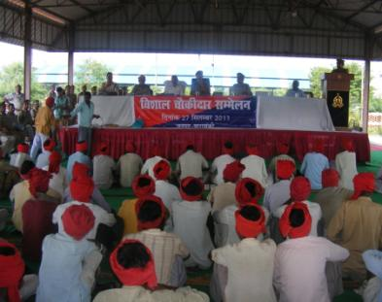
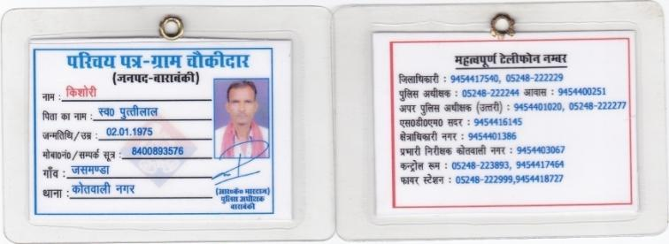
Distributed Identity Cards with phone no. of seniors at back
Joint briefing to all village chawkidars

Slide 125
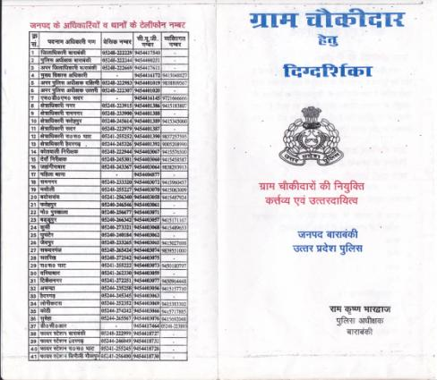
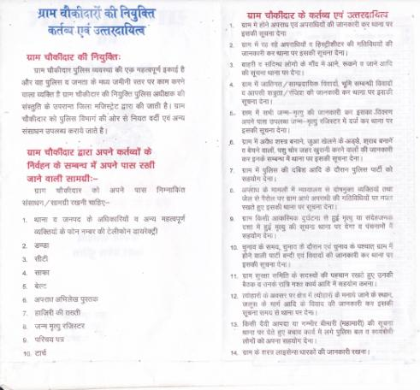
PAMPHLET distributed to all Chawkidars

Slide 126
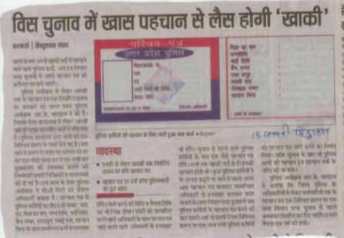
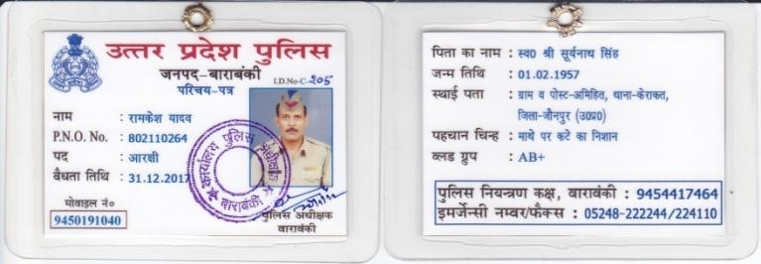
A Laminated I card: Simple step to give identity to my men.

Slide 127
DISTRIBITION OF VILLAGE INFORMATION FORM
Sent to PS in duplicate
COLLECTION OF INFORMATION– A STRONG DATA BASE
Strong Communication
Plan
PREVENTIVE MEASURES
Against troublemakers
General ‘Health’
of Village
VULNERABILITY
MAPPING
(Sensitivity Analysis)
Arms deposition
and cancellation

Slide 128
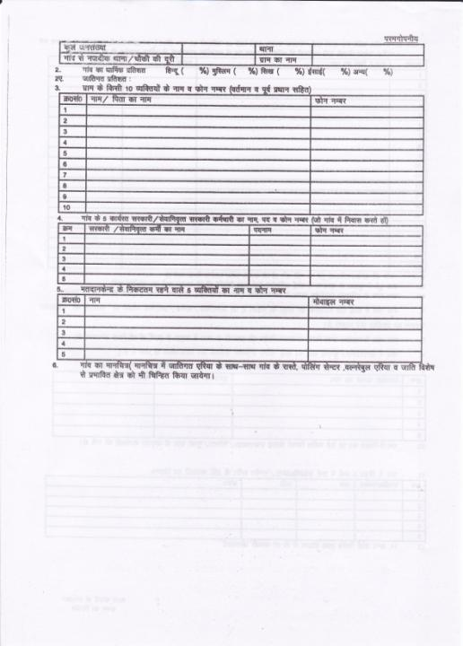
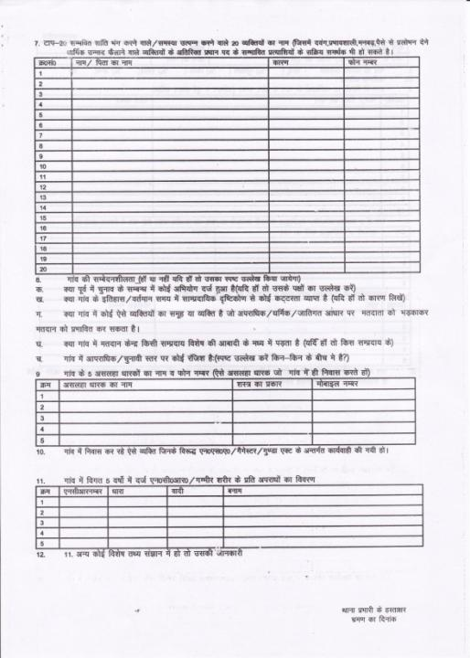
PAGE 1
BACK PAGE

Slide 129
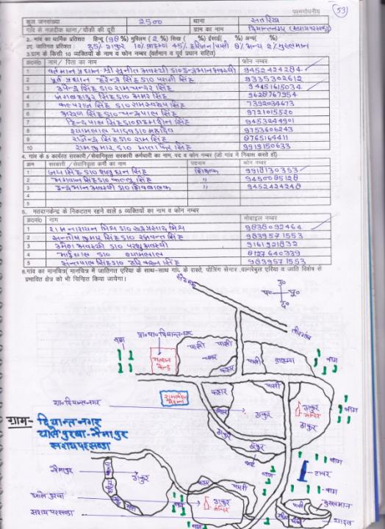
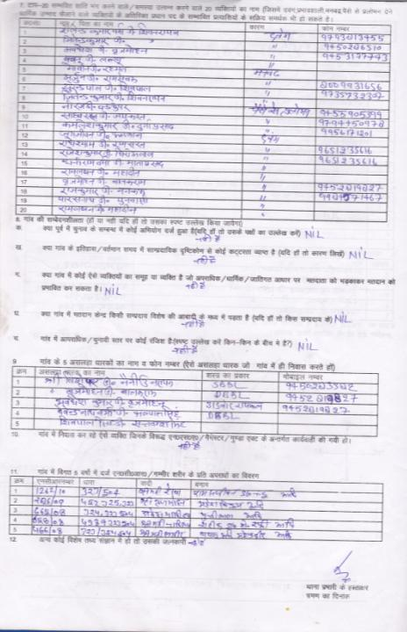
Form completed by PS

Slide 130
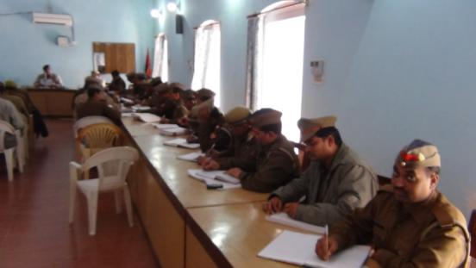
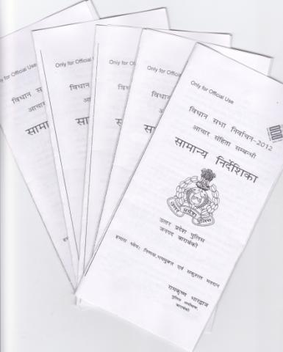
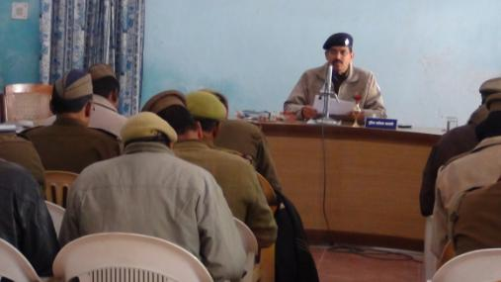
TRAINING ABOUT MCC
MCC Pamphlet distributed to
level of Constabulary

Slide 131
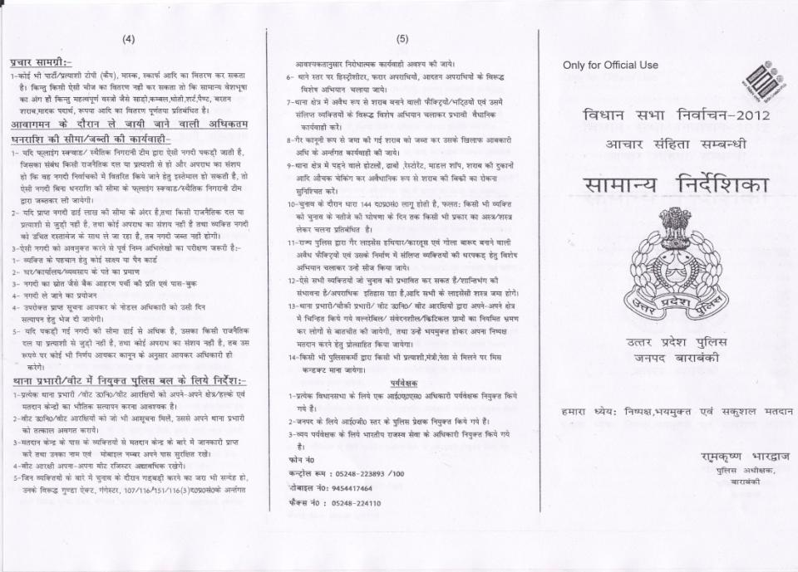

Slide 132
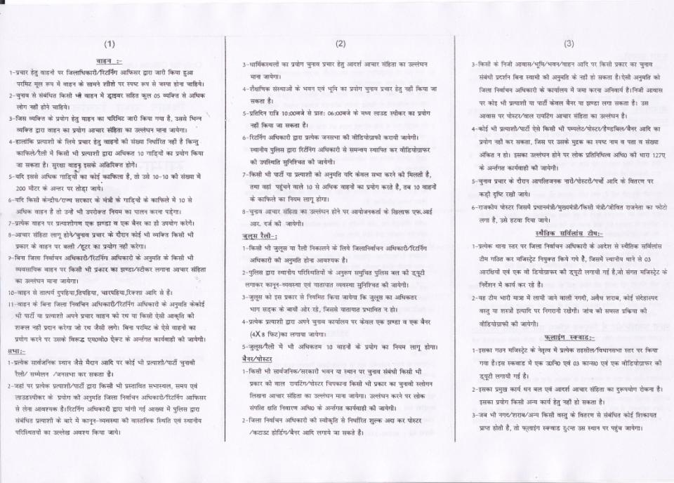

Slide 133
Confidence Building Measures

Slide 134
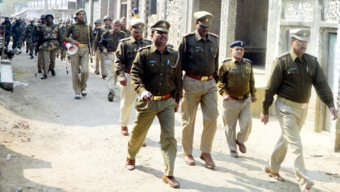
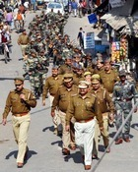
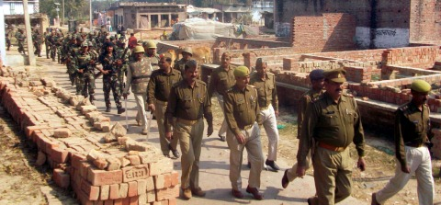
Area Domination: with CPMF
Led by Dy. SP/SHO
Covered ALL villages.
Mostly by foot; or on barriers.
Extensive usage of loudhailers.

Slide 135
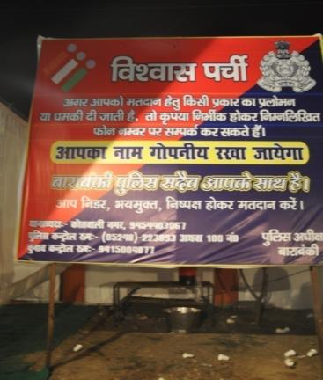
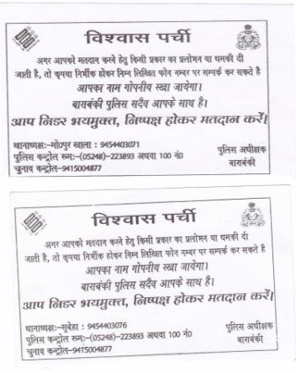
Vishvas Parchi: A District Police initiative to ensure FREE. FAIR and FEARLESS ELECTION
Distributed slips by beat constable to weaker, poor families of all villages.
Nearly 2 lakh families covered ( almost 35% of total voters)
Specifically instructed constable to be polite and explain to them the significance.
10 New lines of 100 no. were taken from BSNL for 20 days, to bear call load.
A Public Hoarding.

Slide 136
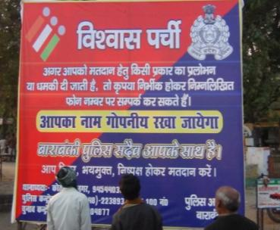
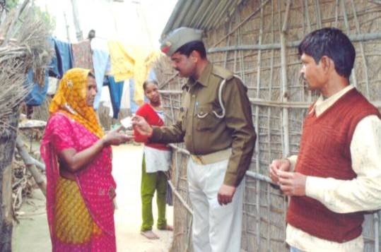
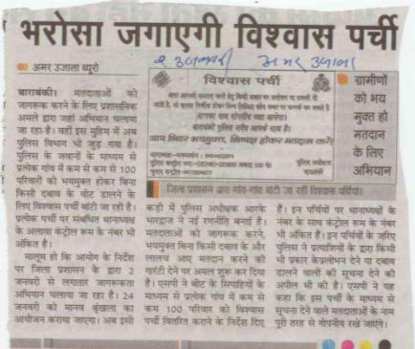
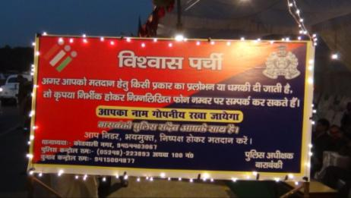

Slide 137
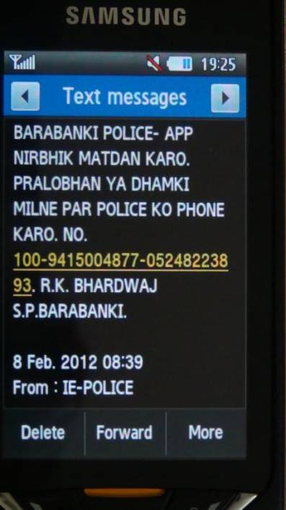
Vishwas SMS:
Bulk SMS sent to all residents of Barabanki on D-2 day, D-1 day and D day(8th Feb) with a message.
It was delivered to ALL mobile company subscribers present in the district.

Slide 138
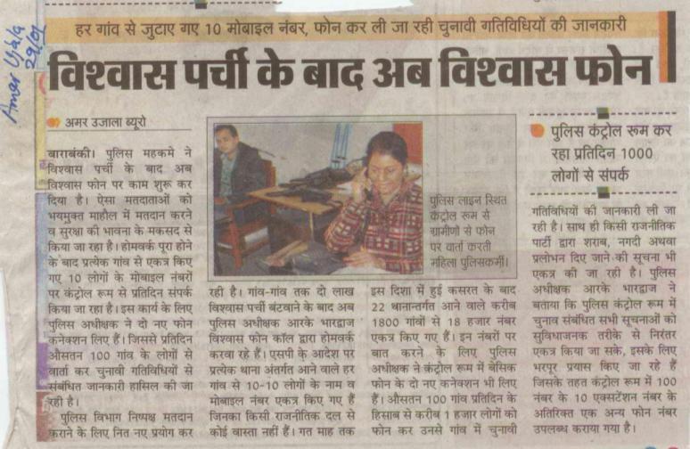
Vishwas phone: Telephonic talk: every day nearly residents of 50 villages( 1000per day).

Slide 139
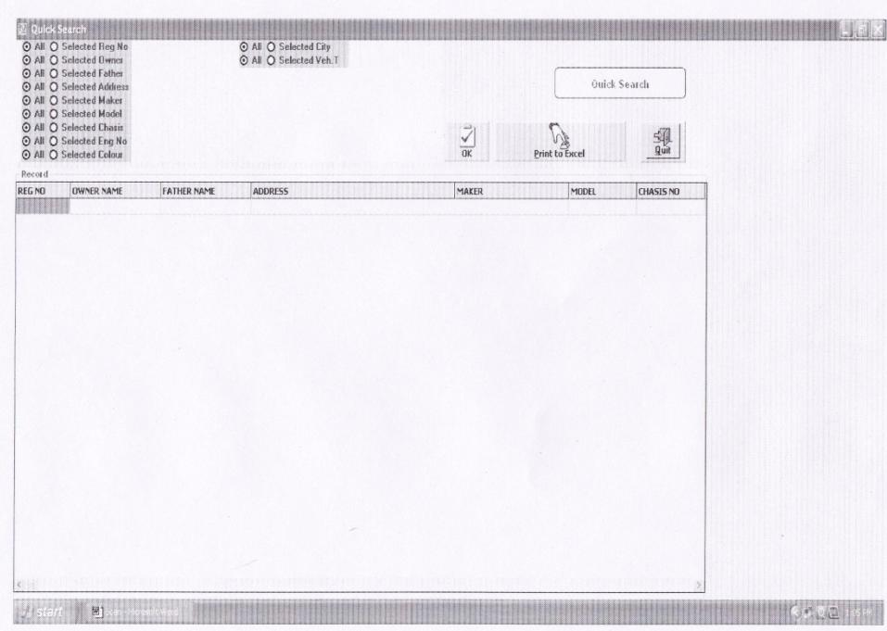
Vehicle search Software:
Data of all vehicles of district and of border district compiled.
Any policeman can contact control room to get immediate information about vehicle
registration detail.

Slide 140
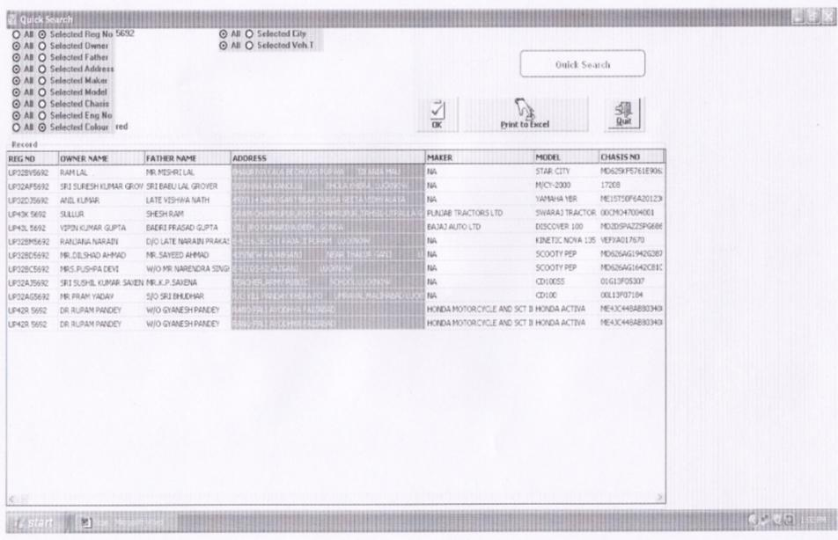
Optional search available
Effect: Total No. of vehicle seized: 63

Slide 141
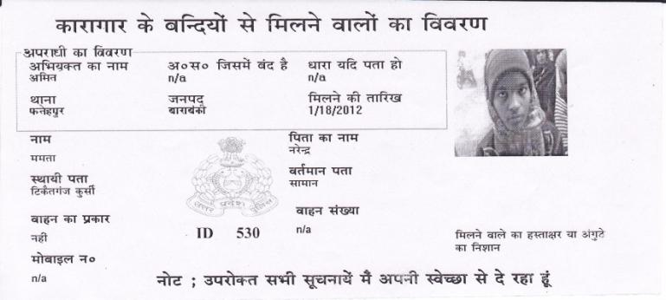
JAIL : close watch
Issuing identity slip to all mulakati’s with photographs.
Search option available :- By mulakati or by jail detenue or by date.
Interestingly no. of person nosedive to just one forth everyday.
Joint raids at jail- without prior notice.
A Mulaqati Slip

Slide 142
DYNAMIC MAP:
Map of district containing all information about district.
About assembly area, PS boundary, Border check post/barrier,
Place of stay and deployment of CPMF.
Vulnerability mapping.

Slide 143
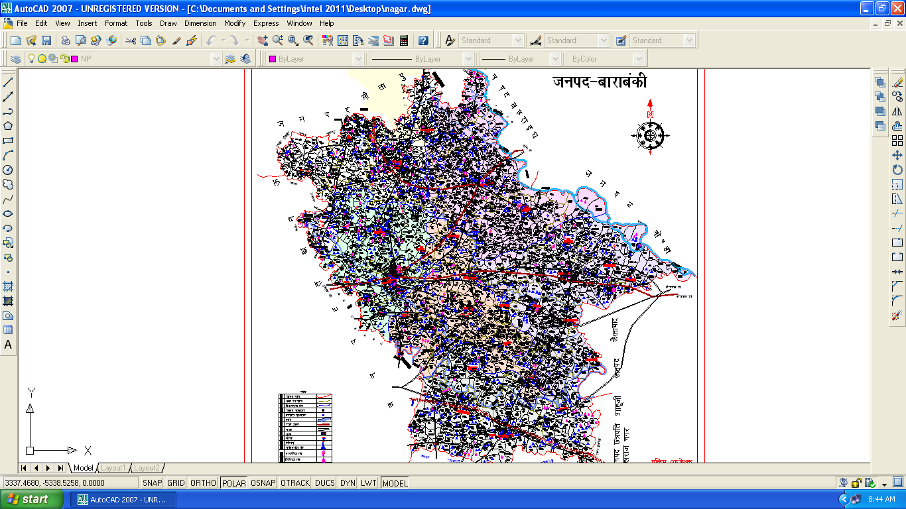

Slide 144
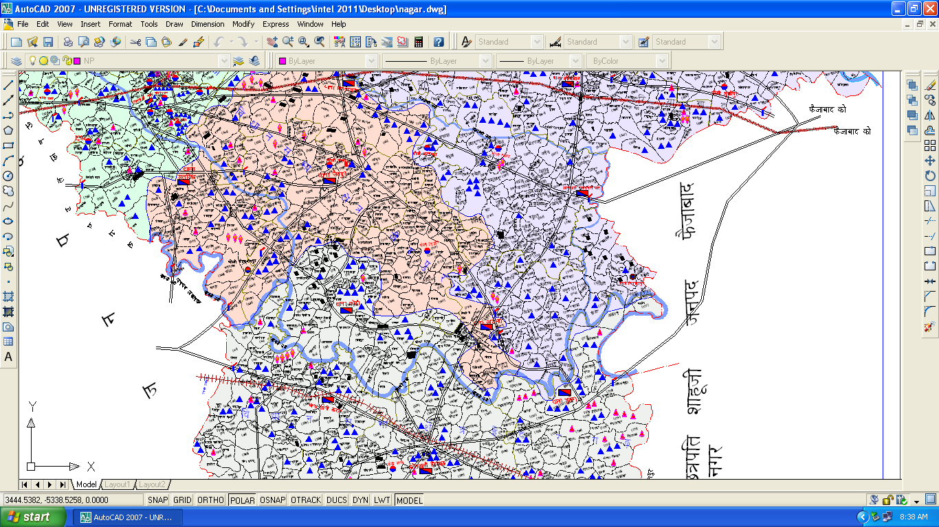

Slide 145
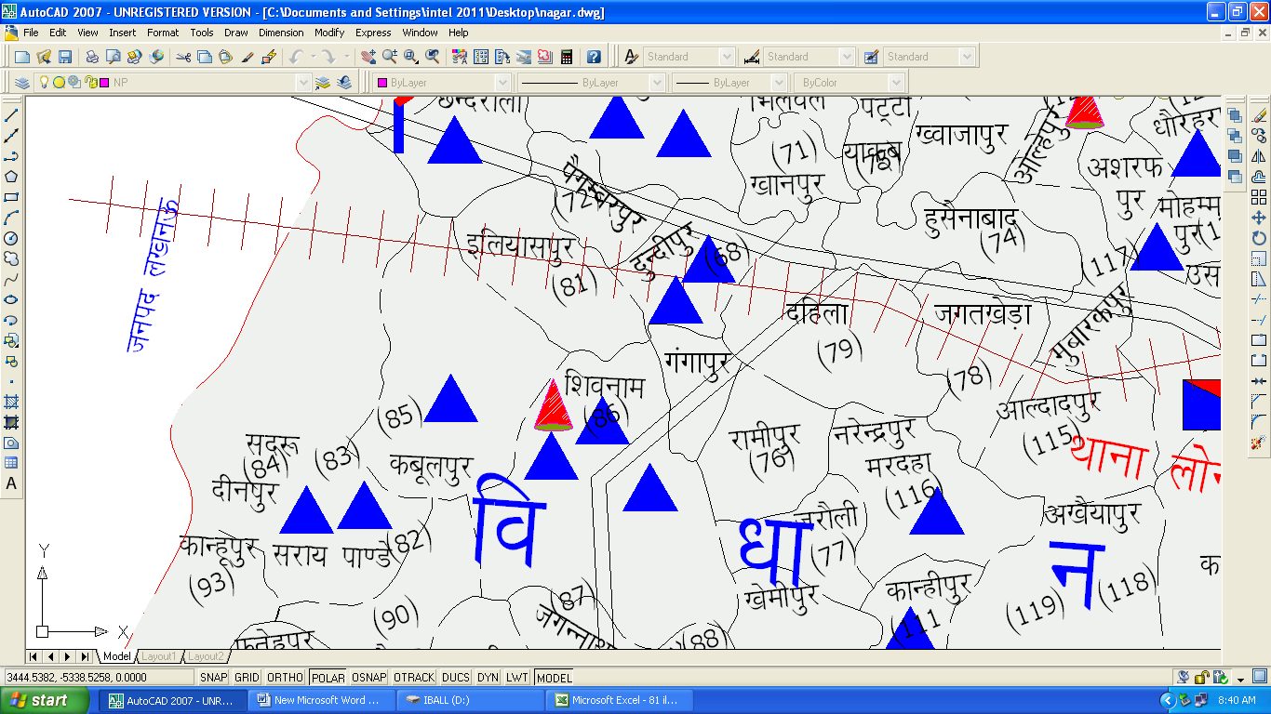
Search option available; by name of polling center, no. of booth etc.

Slide 146
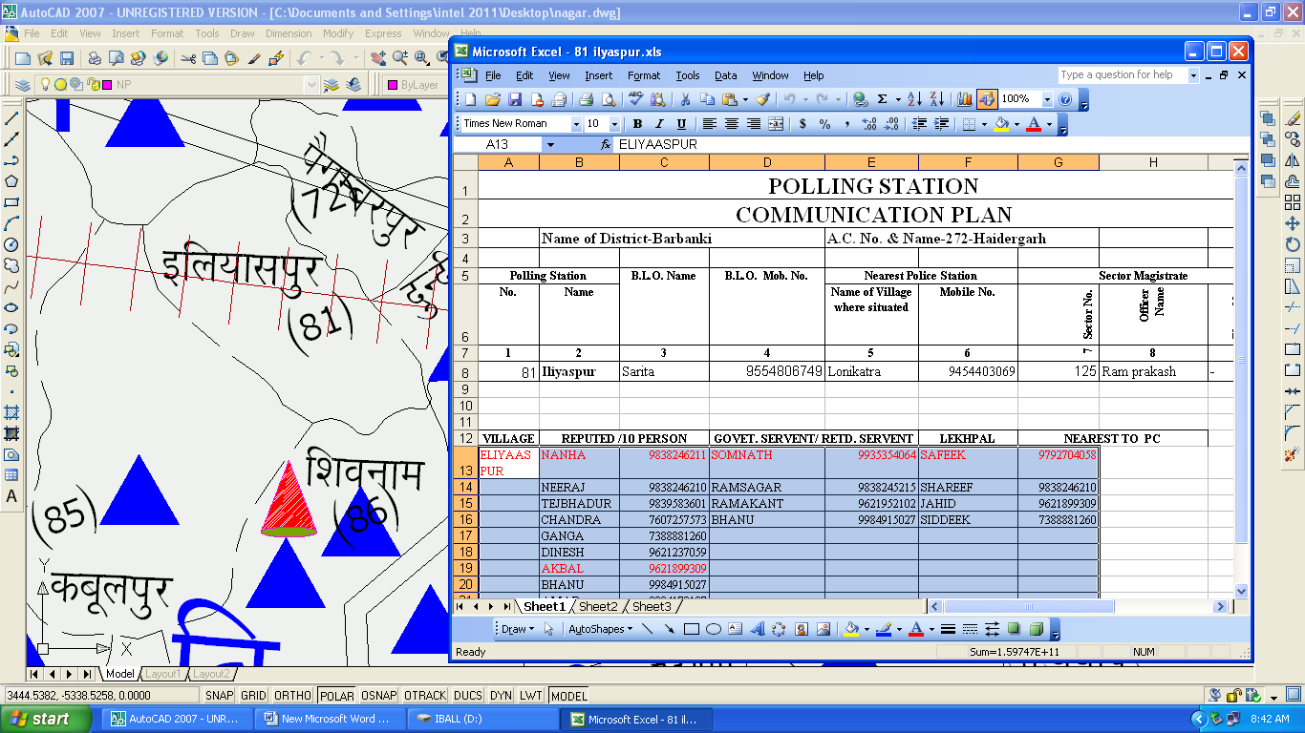
Communication Plan hyper- linked to each Village

Slide 147
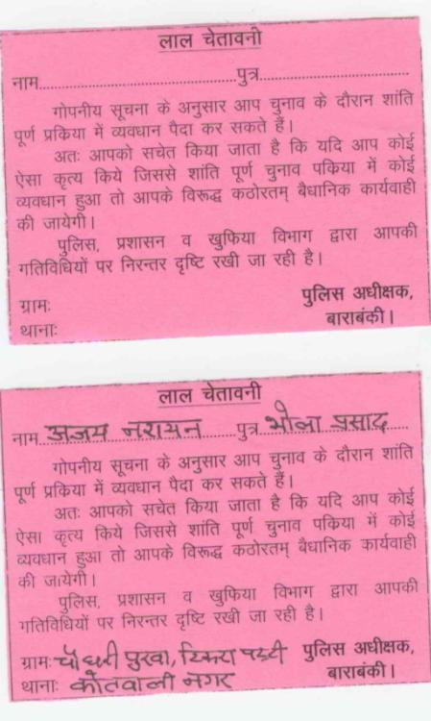
Red Warning card:
Issued to certain probable troublemakers.
Specific and few.

Slide 148
CPMF/PAC ARRANGEMENTS:
Identification of schools classified in A, B, C. Best lot given to CPMF and PAC.
All arrangements made in time: involved CMO, BSA, DIOS, Ex Eng HYDEL, Ex Eng Ground water, DPRO, Principals of schools, ARTO and many others.
Arrival: All CPMF companies received by SHO. Arrival tea was given.
A Welcome Note: handed over to each CC. It contained:
Brief description about district, constituencies, and terrain.
Imp phone numbers of: liaison officer, principal of college; a supply officer (for ration needs), a medical officer and local hospital no.; nodal officer for POL and vehicle;
local SHO no.; control room; senior officers no.
Do’s and Don’ts
Briefing time; reporting time to polling center.
Area Domination Chart.
A Folder: containing
- Duty chart.
- Map showing a company deployment (with vulnerability)- ‘clustered duties’
- Duty card
- Sample passes and duty card.
- Pamphlet.
Briefing twice: up to 0.5 Section in-charge level.
FOOD : through MID DAY MEAL Scheme (to all police deployed at polling center).
Appreciation letter on departure.

Slide 149
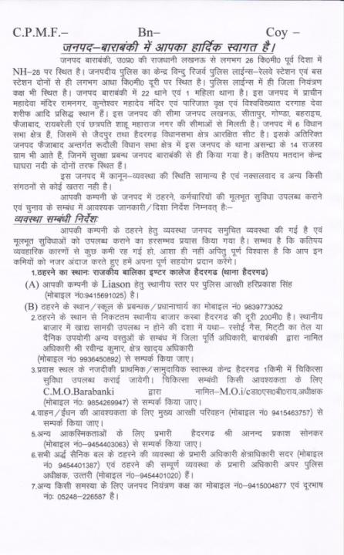
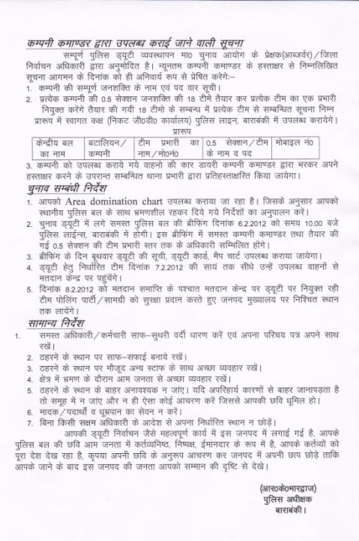
A WELCOME NOTE FOR CPMF- for each CC

Slide 150
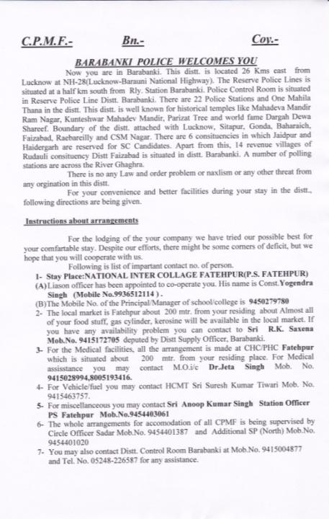
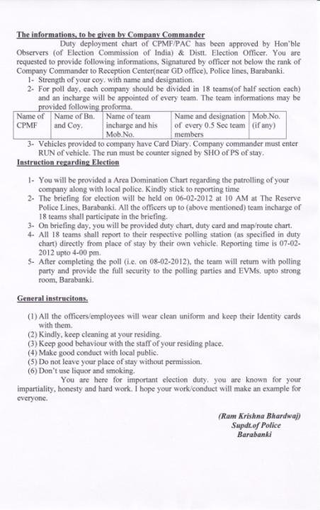
Page 1
Page 2
A WELCOME NOTE FOR CPMF- an English version for Mizo SAP

Slide 151
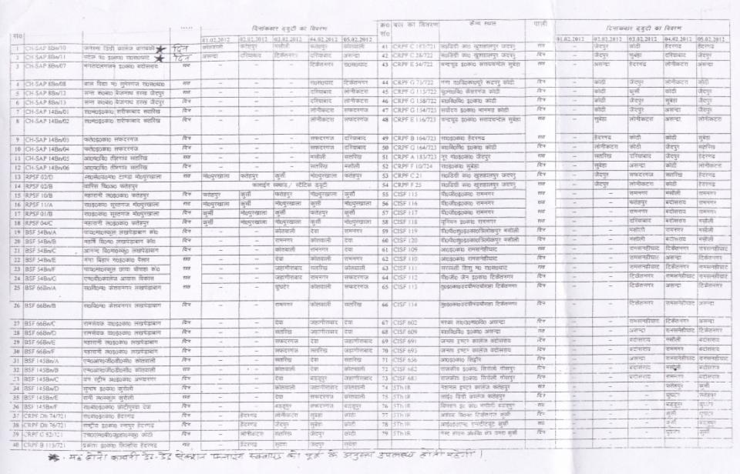
Area domination Chart for CPMF

Slide 152
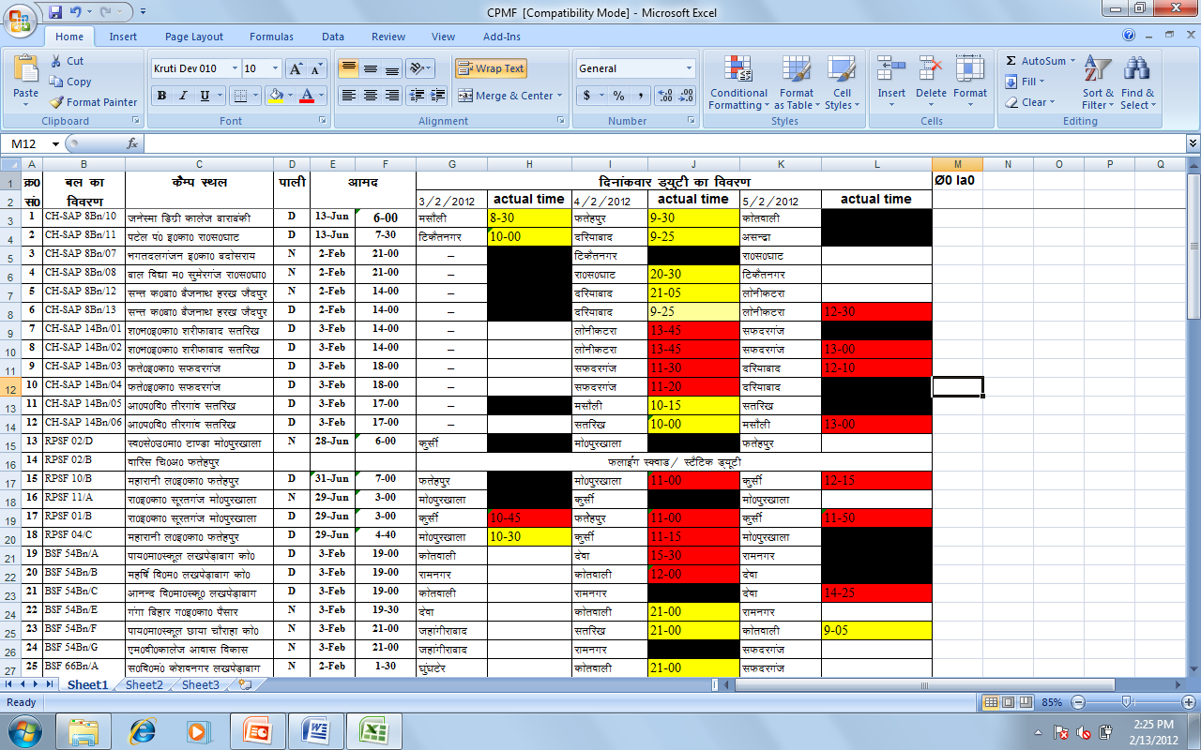
Area Domination being monitored religiously

Slide 153
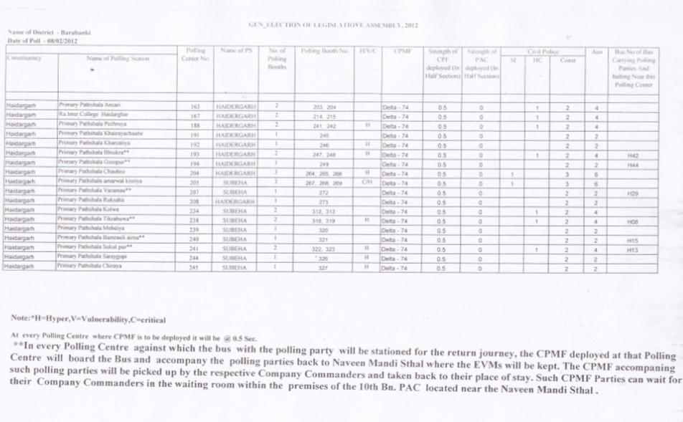
Duty chart.

Slide 154
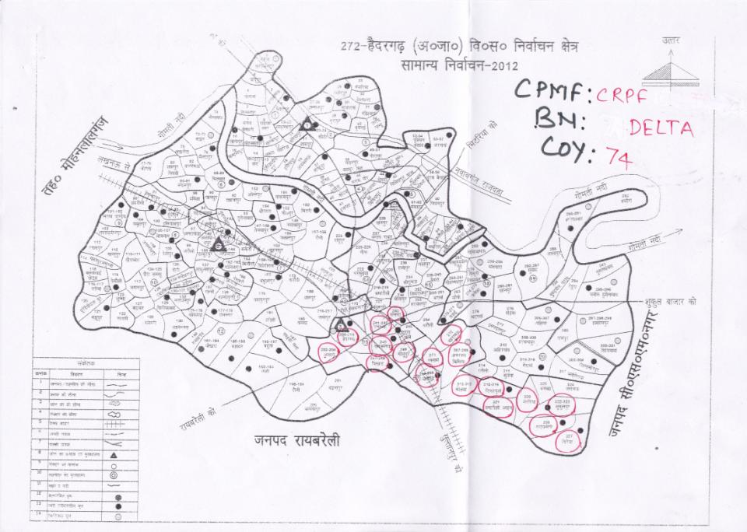
Map showing a company deployment (with vulnerability)- ‘clustered duties’

Slide 155
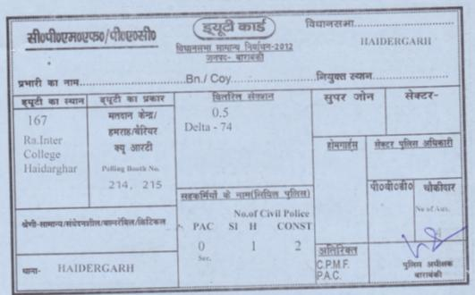
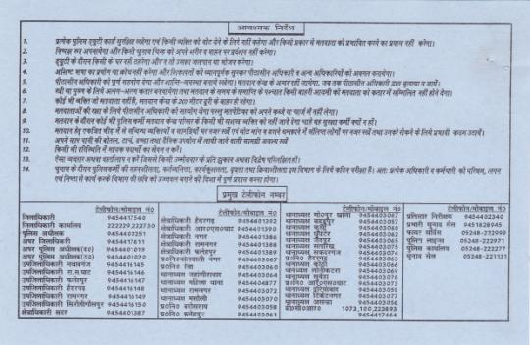
Duty card

Slide 156
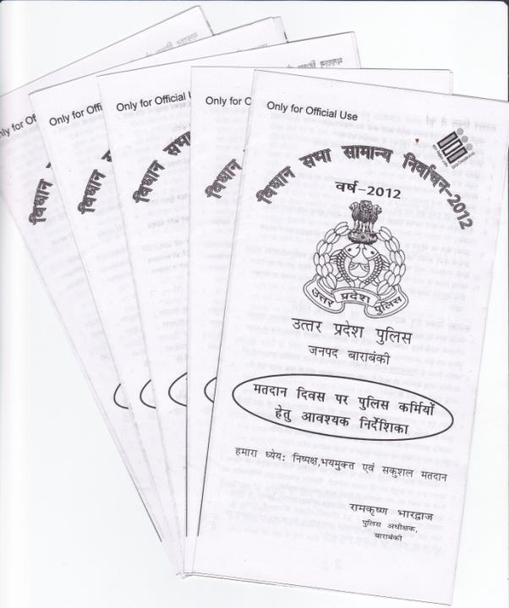
PAMPHLET FOR ALL POLICE PERSONNEL DEPLPOYED ON DAY OF ELECTION

Slide 157
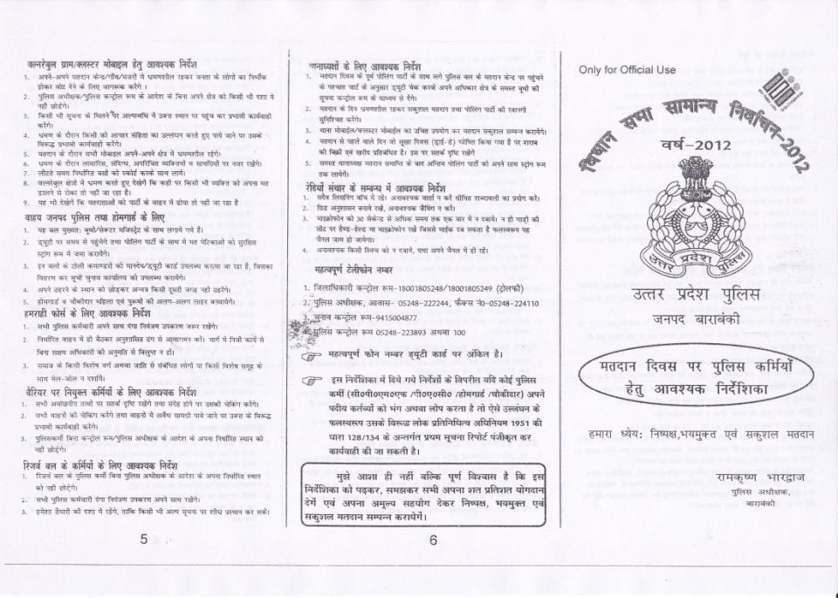

Slide 158
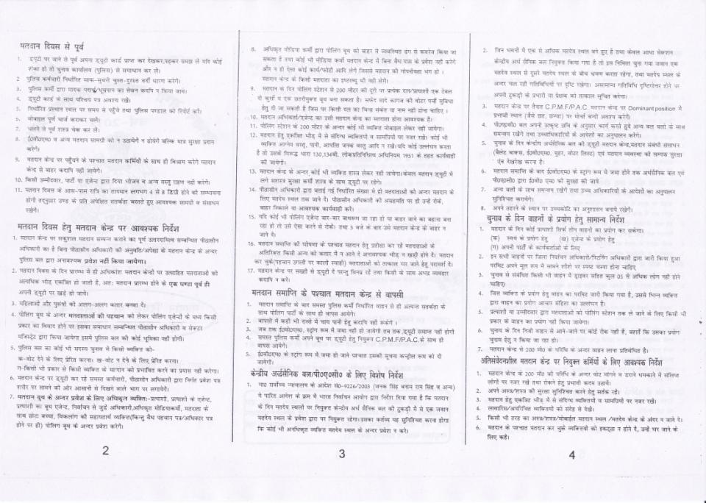

Slide 159
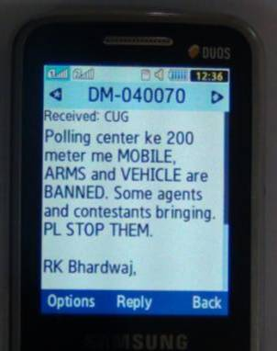
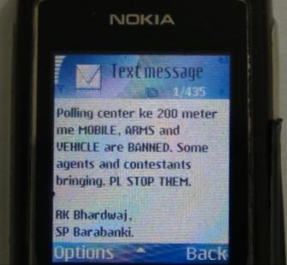
SMS based information dispersal:
All personnel phone no. was compiled according to place of deployment and forces they belong.
Communicated through BULK SMS on Day of Poll.
Prevent jamming on handset.

Slide 160
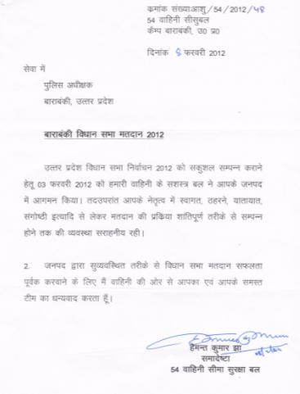
Thanks letters and appreciation from CPMF…
…more after they left district.

Slide 161
….Our Endeavour for Improvement will continue…..
Uttar Pradesh Police
District Barabanki

